Slide 1
Introduction to Market Basket Analysis
A comprehensive guide for Beginner
PRESENTED BY
Shubham Rao
RA2311003030579

Slide 2

Introduction to Market Basket Analysis
Market Basket Analysis helps retailers understand customer purchasing behavior by identifying product associations. This technique reveals patterns that can enhance sales strategies and improve inventory management, ultimately driving profitability and customer satisfaction.

Slide 3
What is Market Basket Analysis?
•
Analyzes Purchase Patterns
Market Basket Analysis examines transaction data to identify common purchasing behaviors among customers.
•
Identifies Product Associations
It reveals which products are frequently bought together, helping retailers understand customer preferences.
•
Supports Targeted Marketing
Insights from analysis enable businesses to create personalized promotions, increasing sales and customer loyalty.

Slide 4
How to Perform Market Basket Analysis
1. Collect Transaction Data
Gather data from sales transactions, ensuring it includes details such as items purchased, quantities, and timestamps.
2. Preprocess Data for Analysis
Clean and format the data by removing duplicates, handling missing values, and structuring it into a suitable format for analysis.
3. Apply Association Rule Mining
Utilize algorithms like Apriori or FP-Growth to identify patterns and relationships between items in the transaction data.

Slide 5
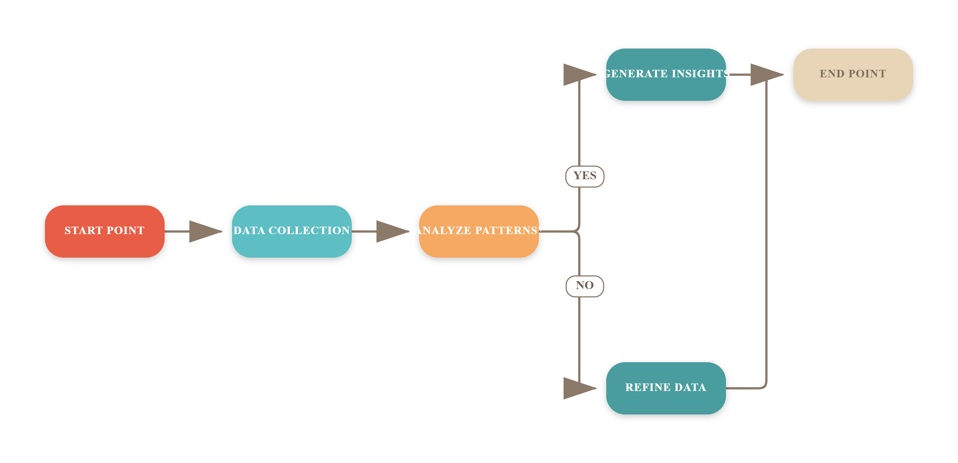
Workflow of Market Basket Analysis

Slide 6
Transformative Impact of Market Basket Analysis
20-30%
15%
5x
Increase in Sales
Improved Customer Retention
Enhanced Cross-Selling Opportunities
Achieved through targeted product recommendations
Resulting from personalized shopping experiences
Leveraging data-driven insights for upselling

Slide 7
Frequently Asked Questions
Q: What tools can I use for market basket analysis?
A: Popular tools include R, Python (with libraries like pandas and mlxtend), and specialized software like RapidMiner or Weka, which offer user-friendly interfaces for beginners.
Q: How do I interpret the results of my analysis?
A: Look for association rules with high support and confidence values; these indicate strong relationships between items that can inform marketing strategies.
Q: What data is needed for effective market basket analysis?
A: You need transaction data that includes item identifiers and transaction IDs, ideally in a format that captures multiple items per transaction.
Q: Can I perform market basket analysis with limited data?
A: While more data generally leads to better insights, you can still derive valuable patterns from smaller datasets; just be cautious about the reliability of your results.

Slide 8
Conclusion
Market basket analysis reveals customer purchasing patterns, enabling targeted marketing strategies. Key takeaways include understanding product affinities, enhancing inventory management, and improving customer experience. Embrace these insights to drive sales and foster customer loyalty in your business.

